Slide 1
Deploying an HTML Page using modern DevOps Tools
Aayushi Pandit
Technology Integration Engineer
14/11/2024

Slide 2
Agenda
1
Project Scope
2
Development Tools
3
Workflow
4
Learnings

Slide 3
PROJECT SCOPE
This project focuses on creating and deploying a web application through a complete DevOps pipeline. It involves building a web page, automating testing and version control, and deploying the final application in a containerized environment to ensure smooth and scalable delivery.
The project’s goal is to streamline the development and deployment process, enabling faster, more reliable releases. Automation and containerization reduce errors, enhance collaboration, and support continuous integration and delivery (CI/CD), making it easier to maintain and scale the application.
Built using HTML, CSS, and Java in Spring Boot, the project uses GitHub for version control and Jenkins for automated testing. It is containerized in Docker, with the Docker image deployed to Docker Hub, establishing an efficient, CI/CD-enabled deployment process.
WHAT?
WHY?
HOW?

Slide 4
DEVELOPMENT TOOLS
SPRING BOOT
Java framework for quick, production-ready apps.
Speeds up development with pre-configured setup.
ECLIPSE
Open-source IDE for Java and more.
Boosts productivity with powerful tools and plugins.
JENKINS
Automation server for CI/CD.
Enables fast, reliable software delivery.
DOCKER
Containerization platform for isolated app environments.
Ensures consistent deployments across stages.

Slide 5
WORKFLOW
HTML webpage creation using Spring Boot
Deployment using Eclipse IDE
Version control with GitHub
Deployment on Docker Hub
Automated Testing with Jenkins
Containerization with Docker

Slide 6
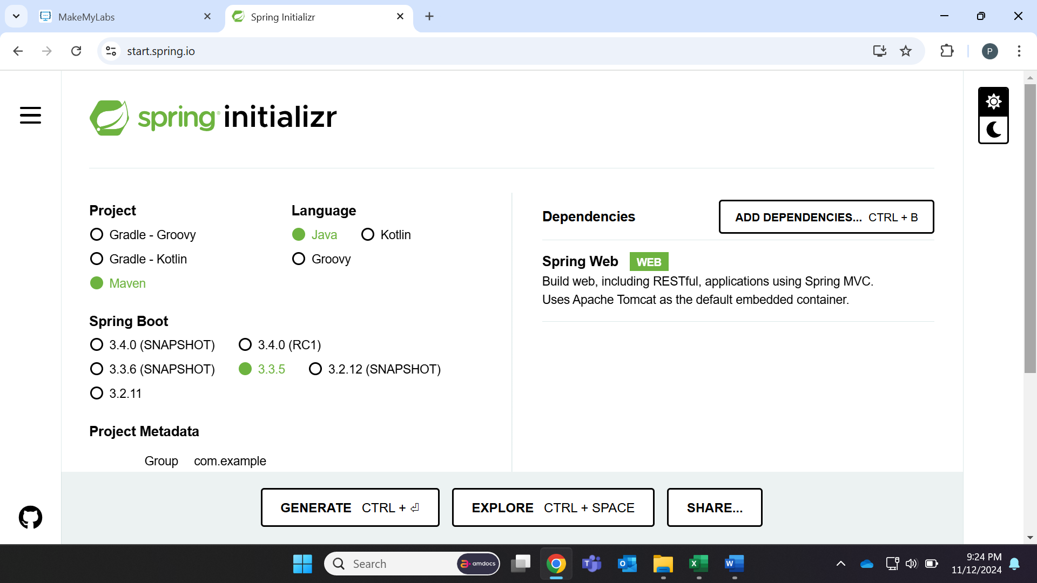
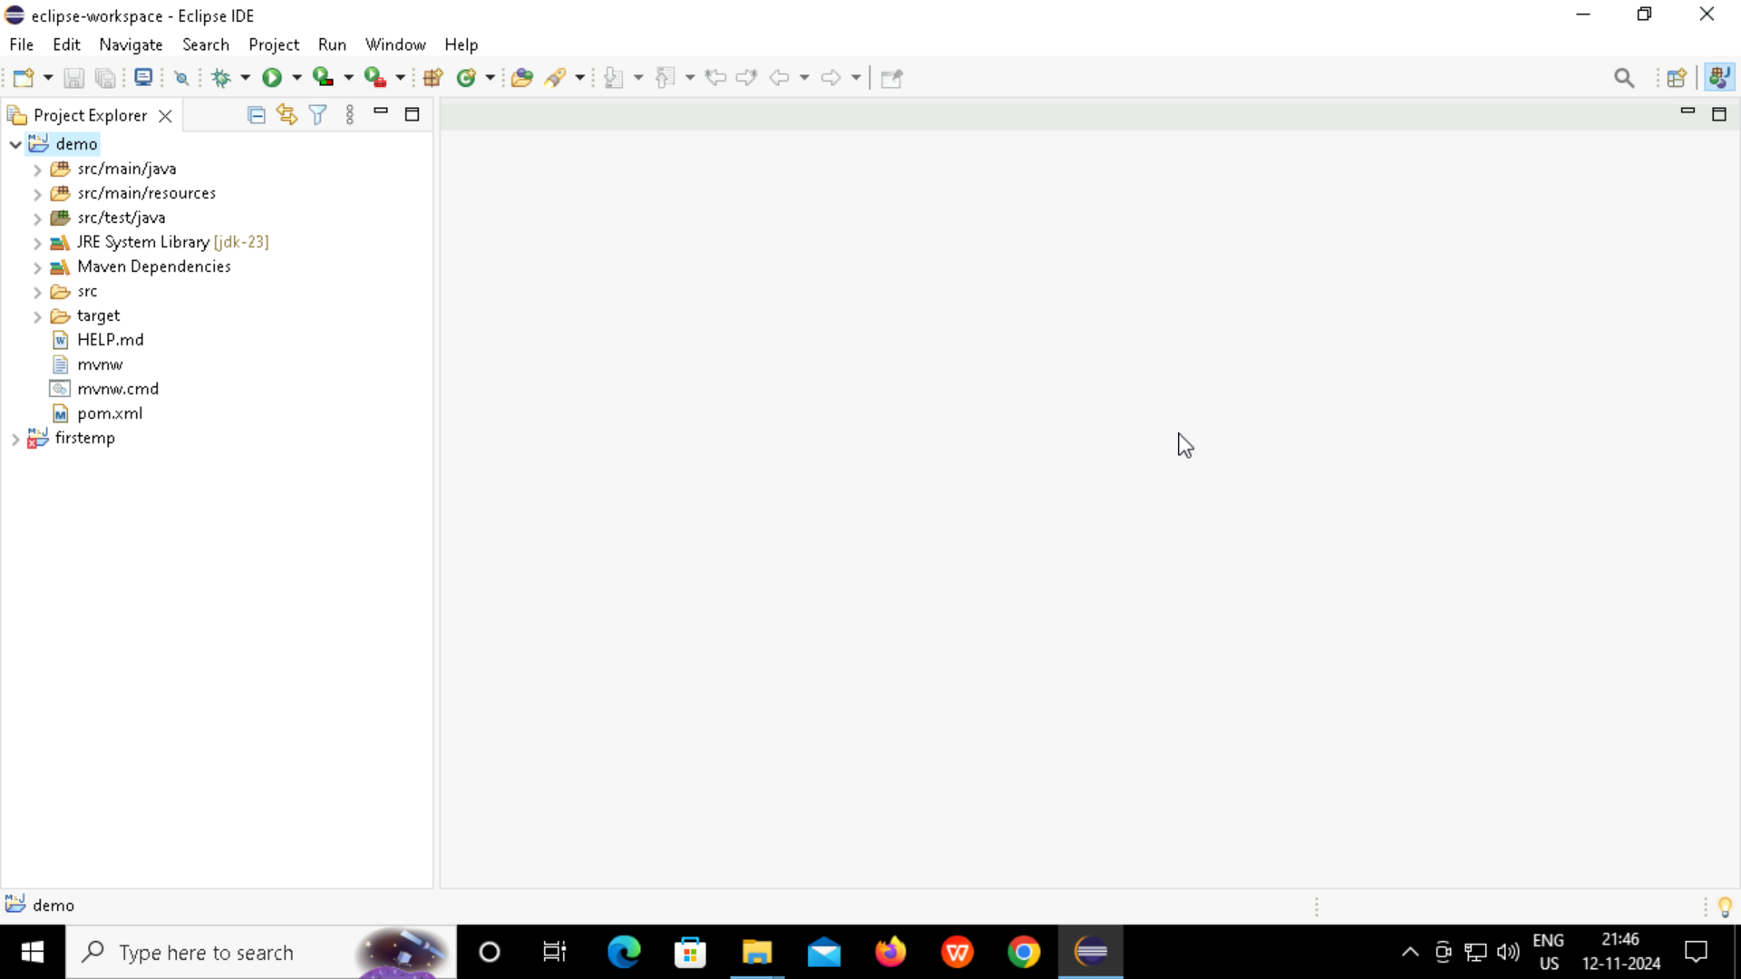
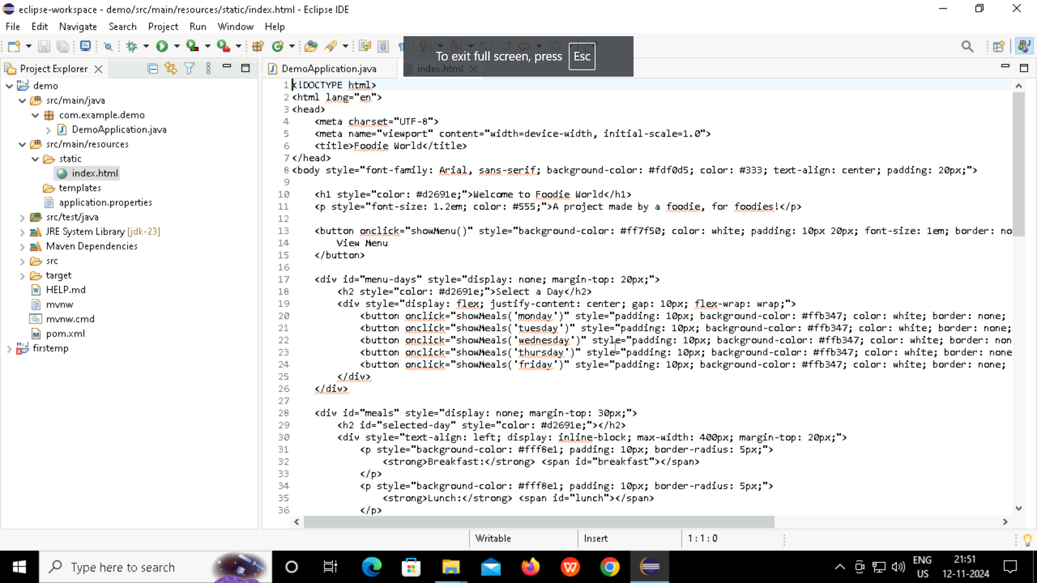
CREATE HTML PAGE USING SPRINGBOOT IN ECLIPSE
Aim: Start with a Spring Boot project to handle backend services, serve HTML content and Local Deployment in Eclipse
Steps:
Step 1: Import the Spring Boot project folder.
Step 2: Modify application.properties to set the port (server.port=8082).
Step 3: Create HomeController with a @GetMapping("/") to map the root URL.
Step 4: Place index.html under src/main/resources/static.
Step 5: Run the application and access it via http://localhost:8082 in your browser.

Slide 7
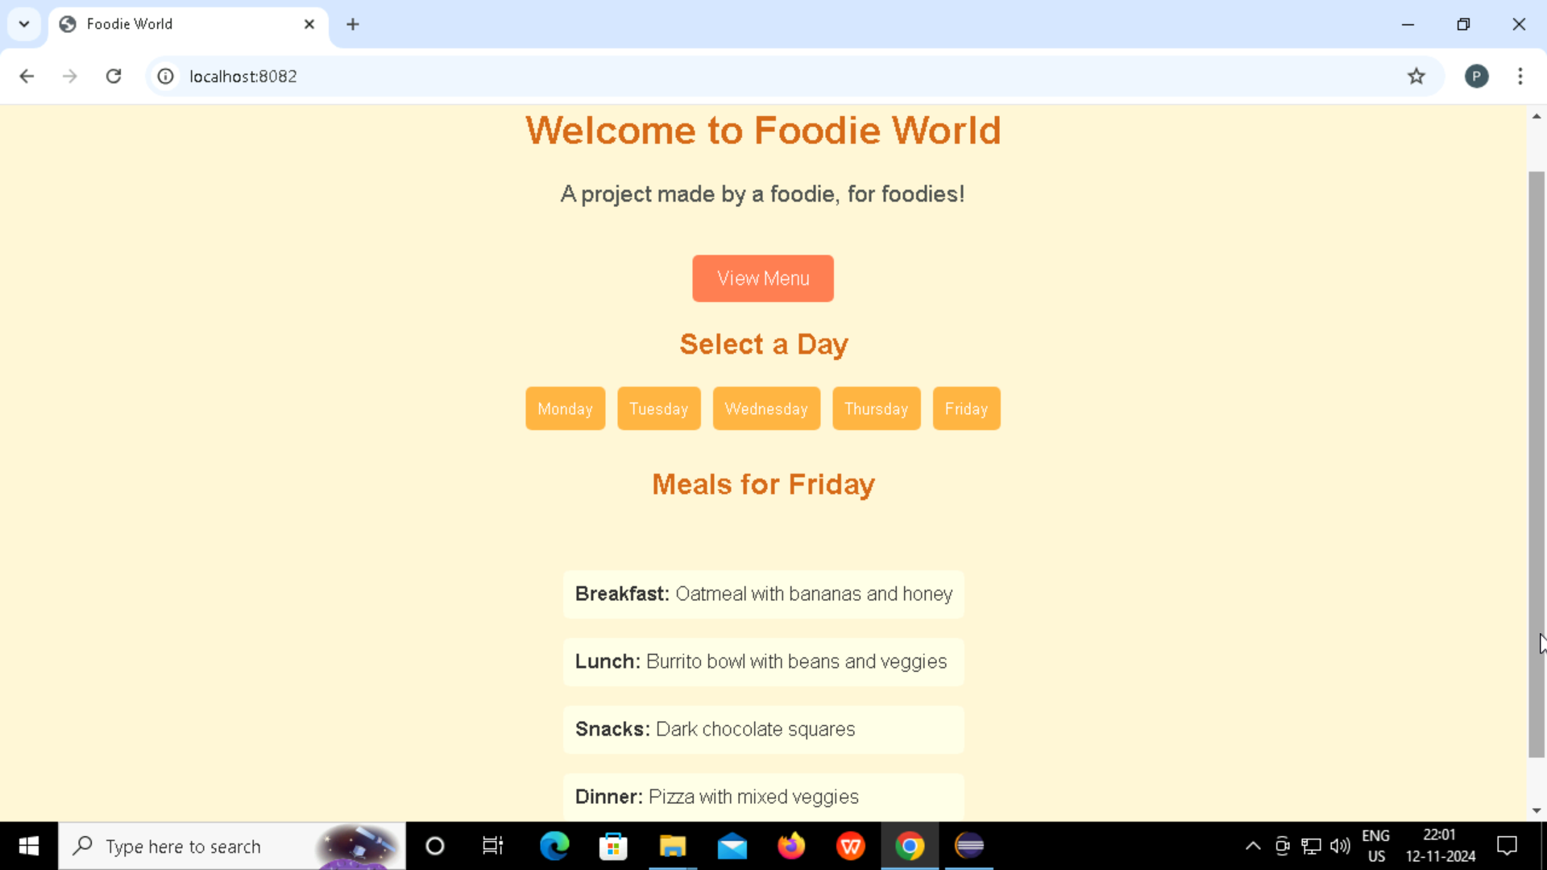
HTML WEBPAGE
Aim: To provide daily and weekly meal plans that inspire food choices, simplify planning, and promote a balanced diet.
Impact:
Enhances user experience with easy access to meal plans.
Encourages balanced nutrition across the week.
Improves meal planning efficiency for users.

Slide 8
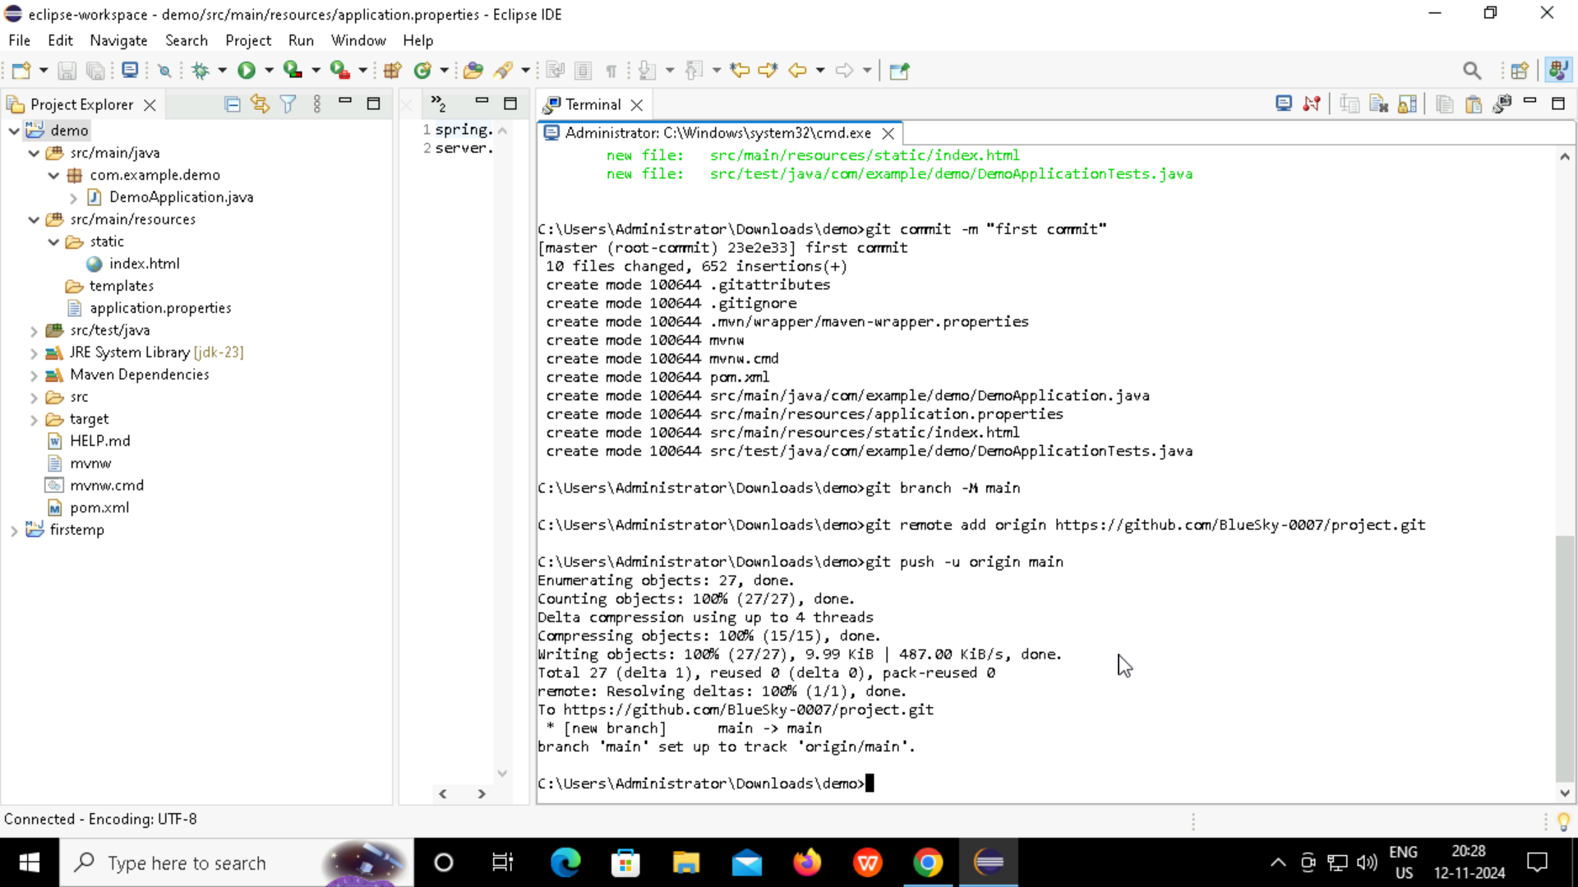
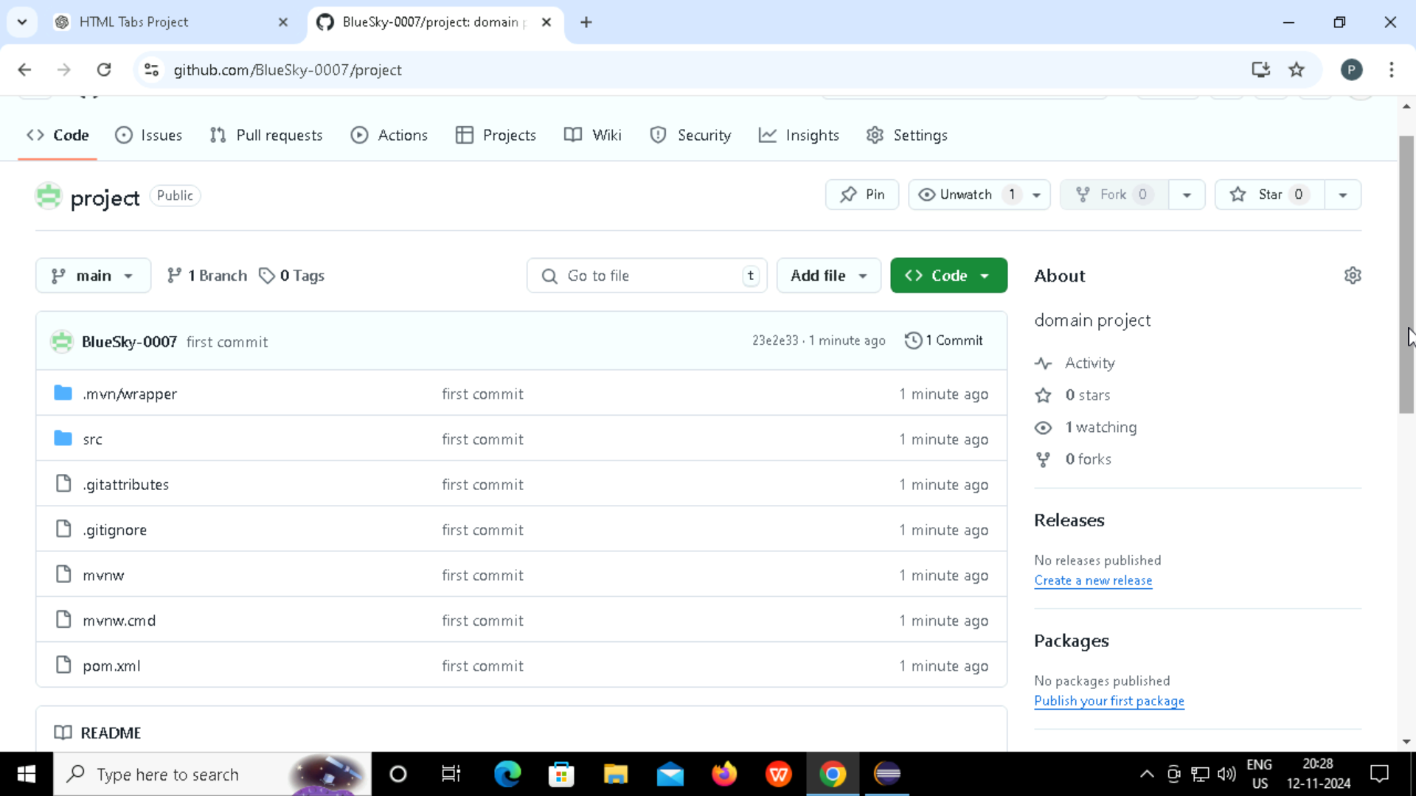
VERSION CONTROL WITH GITHUB
Aim: Push the code to GitHub to enable version control and collaboration.
Steps:
Step-1: Create a new public repository on GitHub.
Step-2: In Eclipse terminal:
git init , git config --global user.name "Your Name“
git config --global user.email "Your Email“ ,
git add .
git commit -m "first commit“ , git branch -M main
git remote add origin <repository_url>
git push -u origin main
Step-3: Check GitHub to confirm files are uploaded.

Slide 9
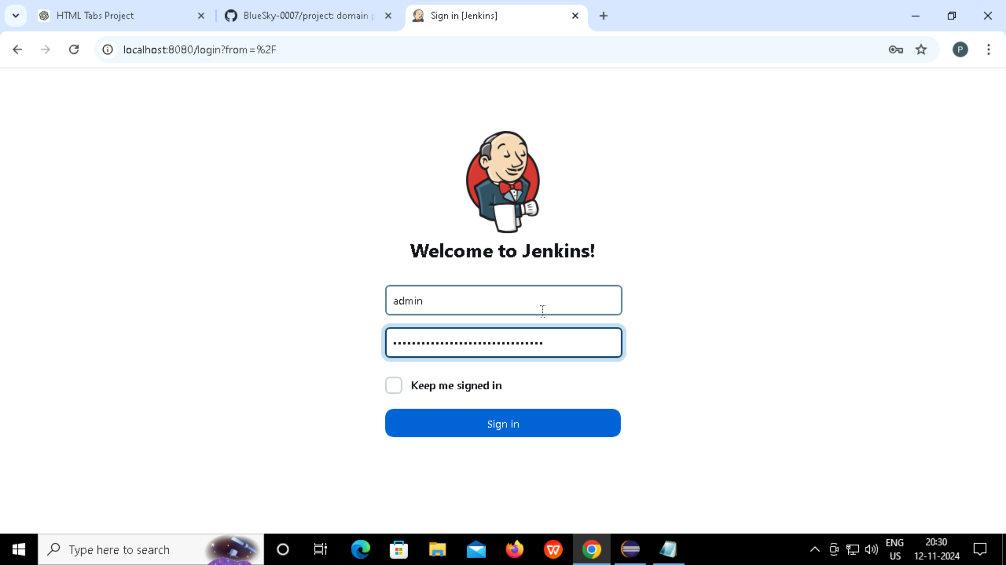
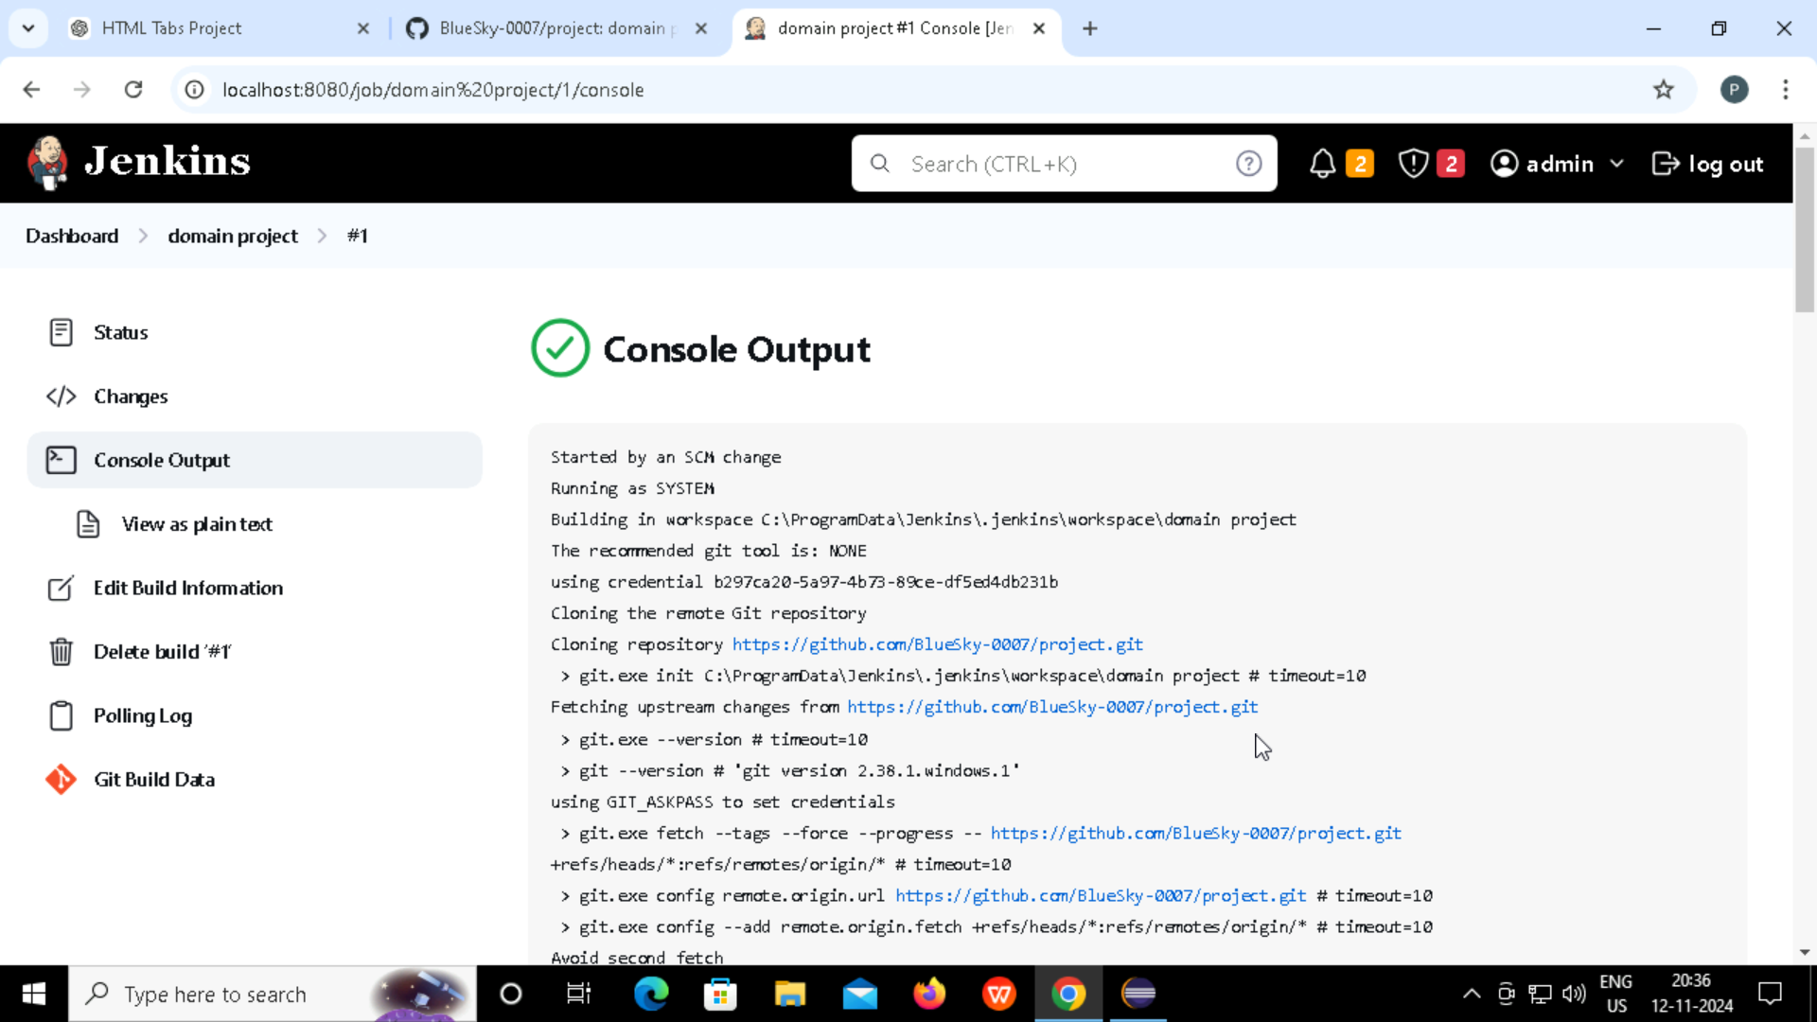
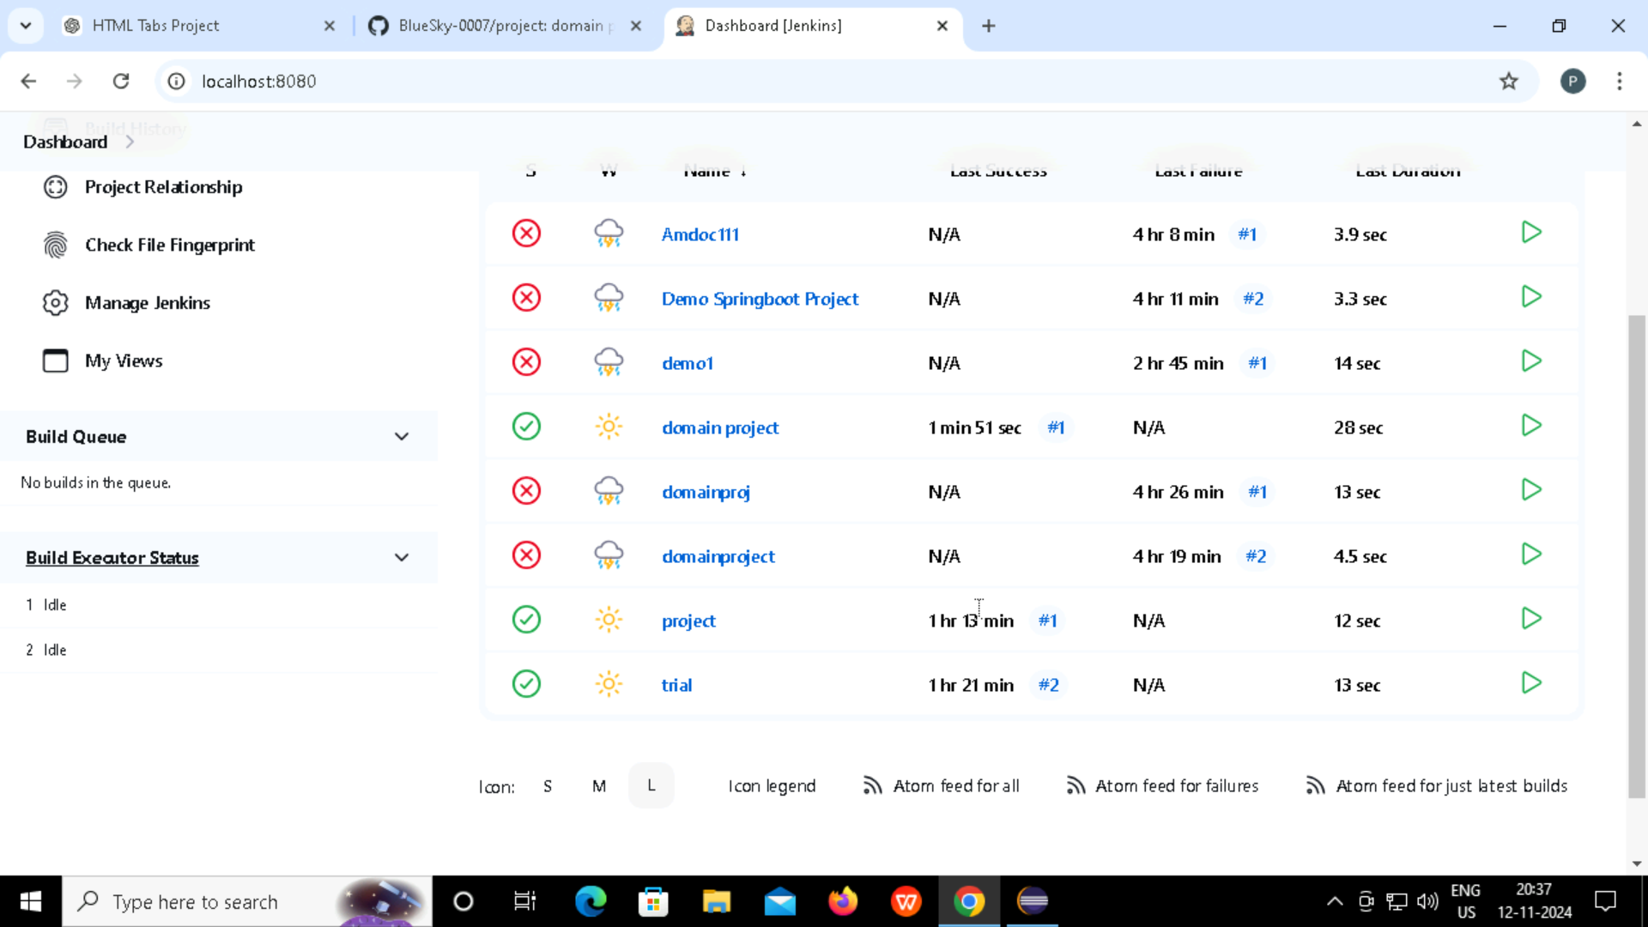
AUTOMATED TESTING WITH JENKINS
Aim: Use Jenkins to automate testing after each push to GitHub.
Steps:
Step-1: Install Jenkins and create a new "Freestyle project" job.
Step-2: Configure the GitHub repository URL and set up a build trigger (polling).
Step-3: Add build steps to pull updates from the repository.
Step-4: Verify the job is running correctly from the Jenkins Dashboard.

Slide 10
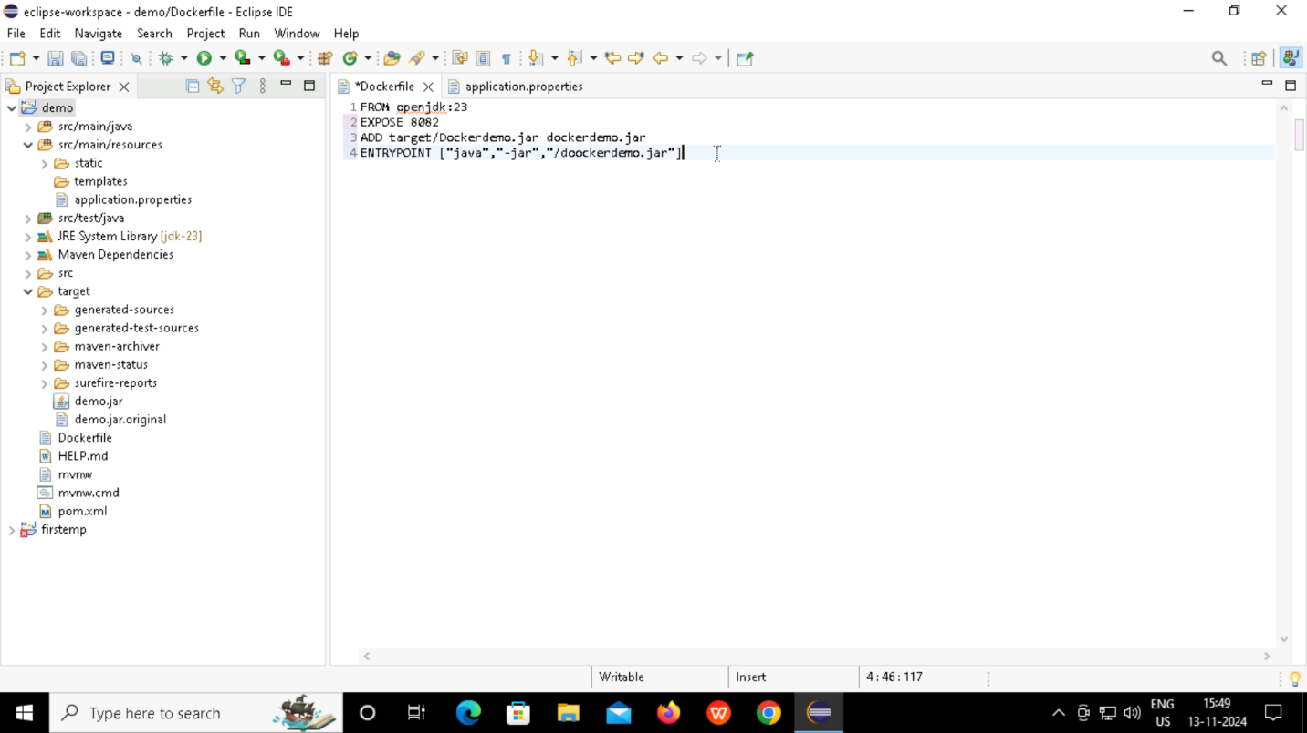
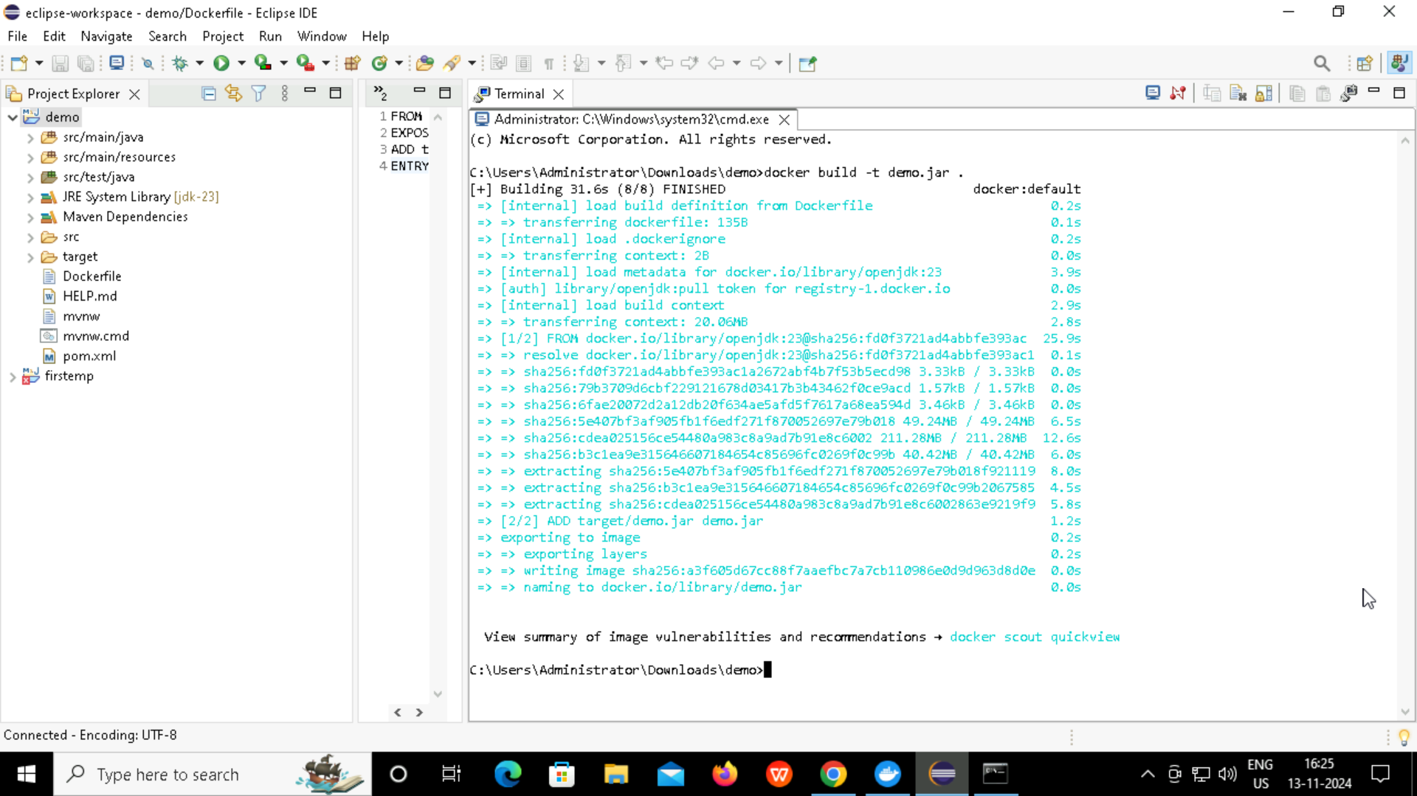
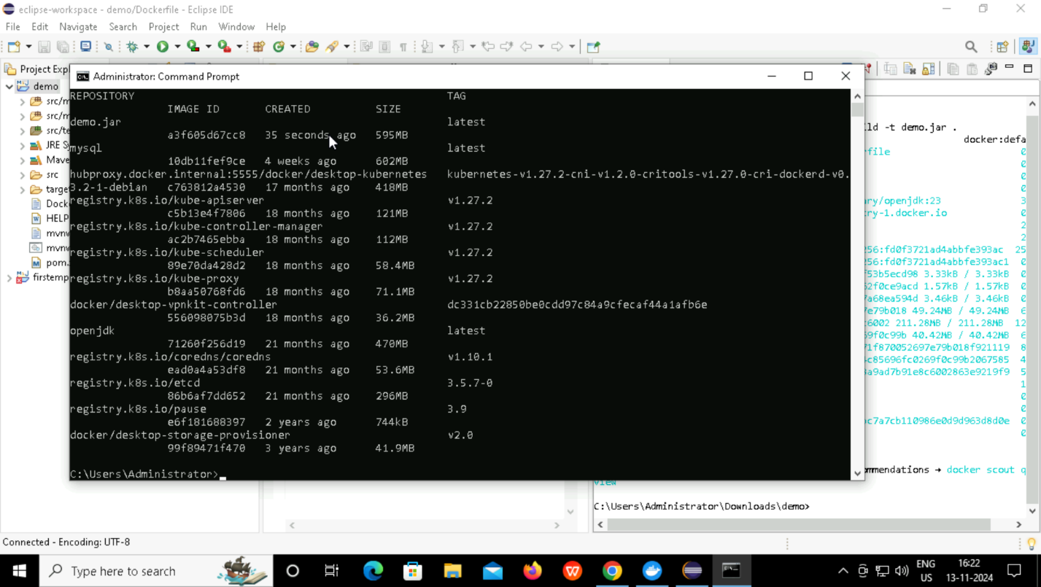
BUILD DOCKER FILE AND IMAGE
Aim: Create a Docker image to containerize the application for consistent deployment.
Steps:
Step-1: Add <finalName>app-name</finalName> in <build> section of pom.xml.
Step-2: Create Dockerfile in Eclipse.
Step-3: Run maven build package.
Step-4: Build Docker Image: Run docker build -t app-name ..
Step-5: Verify Image: Run docker images to confirm app-name exists.

Slide 11
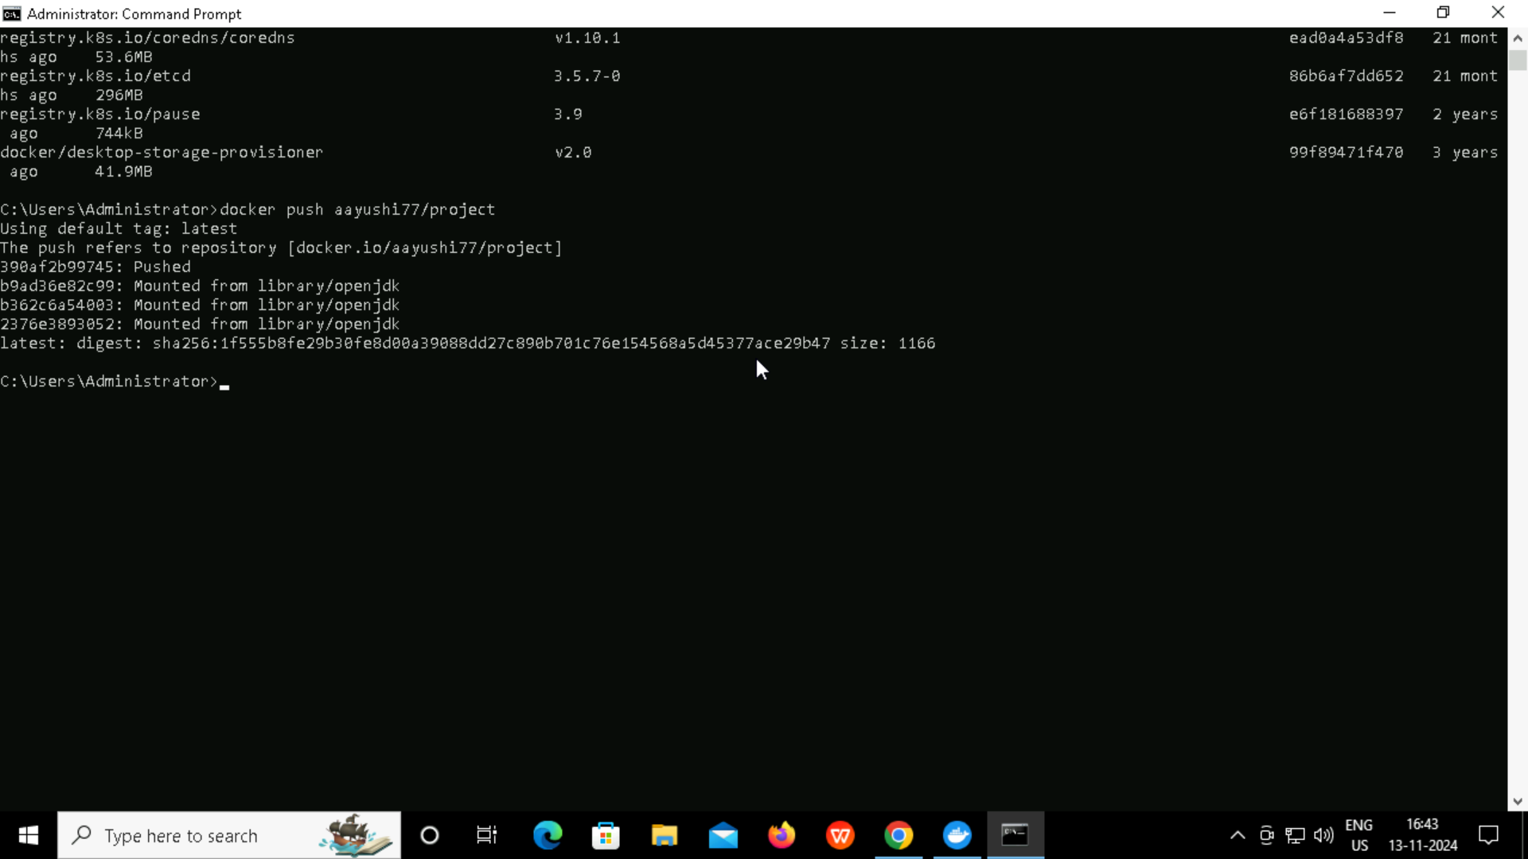
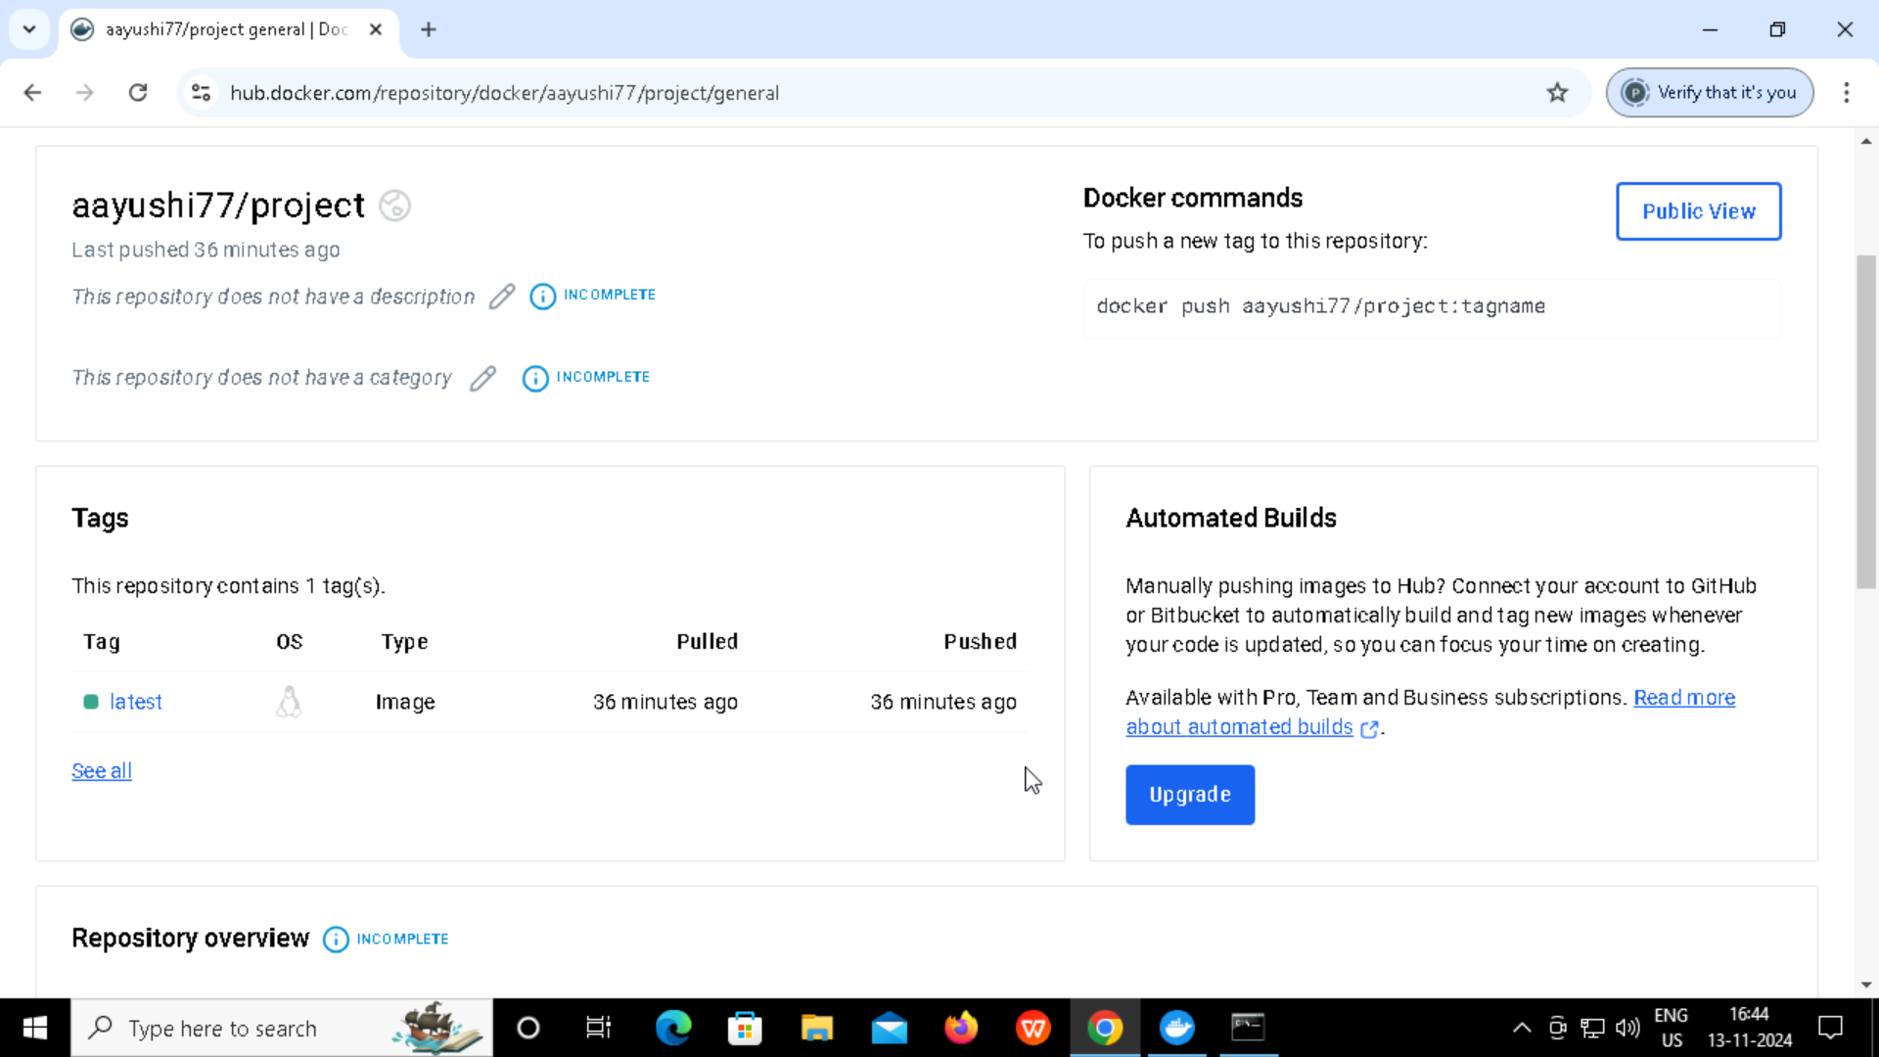
PUSHING DOCKER IMAGE TO DOCKER HUB
Aim: Push the Docker image to Docker Hub for accessible, scalable deployment.
Steps:
Step-1: Log in to Docker Hub and create a repository.
Step-2: Tag the image: docker tag demo.jar aayushi77/project.
Step-3: Push the image: docker push aayushi77/project.
Step-4: Verify on Docker Hub that the image was pushed successfully.

Slide 12
LEARNINGS
Learned to install and build projects using Spring Boot, Eclipse, Jenkins, and Docker.
Enhanced collaboration and communication skills
Gained proficiency in debugging and resolving errors in projects.
Strengthened problem-solving abilities
Became more adaptable to new technologies
Gained confidence in end-to-end deployment

Slide 13
Thank you!

